Slide 1

ENGINEERING CHEMISTRY
Lata Pasupulety
Department of Science and Humanities

Slide 2

ENGINEERING CHEMISTRY
Module 4- Electrochemical equilibria
Class content:
Glass electrode
Construction
Working
Determination of pH

Slide 3
ENGINEERING CHEMISTRY
Module 4- Electrochemical equilibria
Glass electrode
Ion-selective electrode
Responds to Hydrogen ion
pH sensitive; can be used to determine pH of a solution
Consists of a glass membrane which is capable of exchanging H⁺ ions

Slide 4
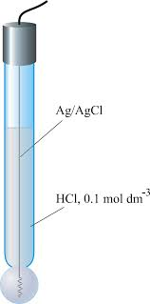
ENGINEERING CHEMISTRY
Module 4- Electrochemical equilibria
Construction:
Glass tube , the end of which is a bulb of very thin glass membrane
Glass bulb is made up of special type of glass, CORNING 015
The glass bulb is filled with solution of known pH which is the reference solution
A silver - silver chloride electrode is dipped inside the reference solution serves as internal reference electrode and also provides external electrical contact
The electrode is immersed in a solution containing H⁺ which is the analyte
Ag/AgCl/HCl/glass
Source:https://glossary.periodni.com/glossary.php?en=glass+electrode

Slide 5
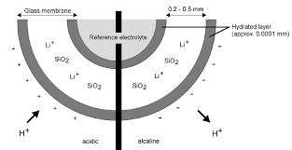
ENGINEERING CHEMISTRY
Module 4- Electrochemical equilibria
Working:
analyte solution reference solution Ag-AgCl electrode
[H⁺] = C₁ [H⁺] = 0.1M HCl = C₂
H⁺ _{solution} + Na⁺Gl⁻ ⇌ Na⁺_{solution} + H⁺Gl⁻
The inner and outer surfaces of the glass membrane can exchange H⁺ ions with the solution they are in contact with
The hydrated glass membrane brings about ion exchange reaction between singly charged cations in the interstices of glass lattice and protons from the solution
A potential is developed, which is a function of H⁺ of the solution
Source:http://www.metrohmsiam.com/teachingresearch/TRL_25/TRL25_955207_80155013.pdf

Slide 6
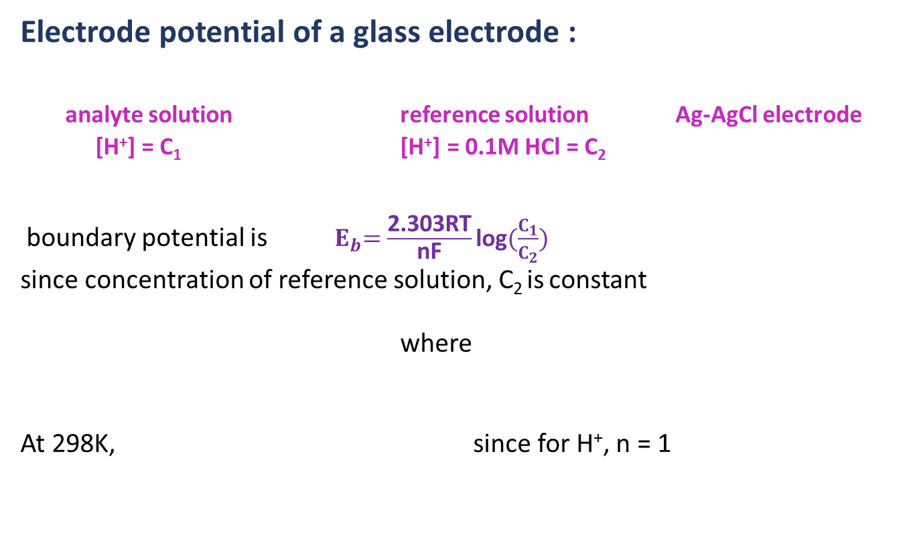

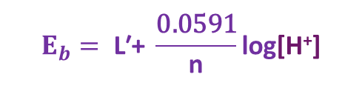

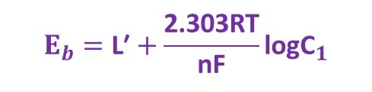
ENGINEERING CHEMISTRY
Module 4- Electrochemical equilibria
Electrode potential of a glass electrode :
analyte solution reference solution Ag-AgCl electrode
[H⁺] = C₁ [H⁺] = 0.1M HCl = C₂
boundary potential is${ E}_{b}=\frac{\text{2.303}\text{RT}}{\text{nF}}\text{log}(\frac{C_{1}}{C_{2}})$
since concentration of reference solution, C₂ is constant
where
At 298K, since for H⁺, n = 1
$$E_{b}=\text{L}\text{′}+\frac{\text{2.303}\text{RT}}{\text{nF}}\text{log}{\text{C}}_{1}$$
$$\text{L}\text{′}\text{= −} \frac{\text{2.303}\text{RT}}{\text{nF}}\text{log}{\text{C}}_{2}$$
$$E_{b}= \text{L}\text{′+} \frac{\text{0.0591}}{\text{n}}\text{log}\text{[}\text{H}\text{+}\text{]}$$
$$E_{b}=\text{L}\text{′}−0.0591\text{pH}$$

Slide 7
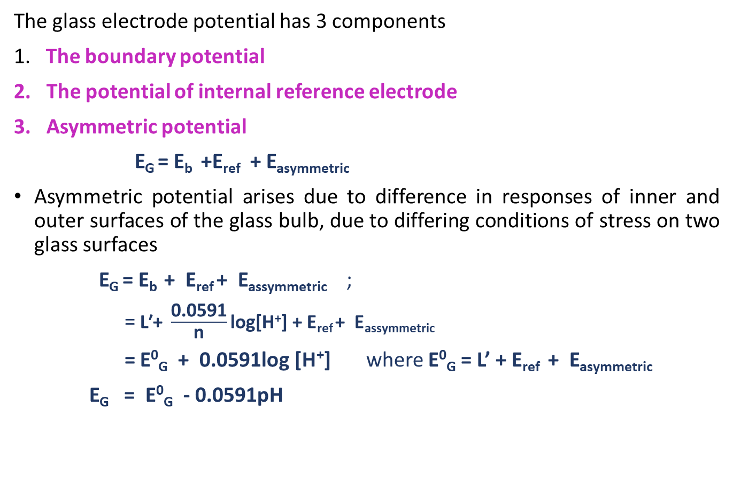
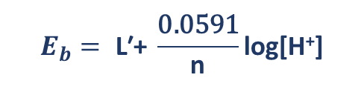
ENGINEERING CHEMISTRY
Module 4- Electrochemical equilibria
The glass electrode potential has 3 components
1. The boundary potential
2. The potential of internal reference electrode
3. Asymmetric potential
E_{G} = E_{b} +E_{ref} + E_{asymmetric}
Asymmetric potential arises due to difference in responses of inner and outer surfaces of the glass bulb, due to differing conditions of stress on two glass surfaces
E_{G} = E_{b} + E_{ref} + E_{assymmetric} ;
= $\text{L}\text{′+} \frac{\text{0.0591}}{\text{n}}\text{log}\text{[}\text{H}\text{+}\text{]}$ + E_{ref} + E_{assymmetric}
= E⁰_{G} + 0.0591log $\text{[}\text{H}\text{+}\text{]}$ where E⁰_{G} = L’ + E_{ref} + E_{asymmetric}
E_{G} = E⁰_{G} - 0.0591pH
$$E_{b}= \text{L}\text{′+} \frac{\text{0.0591}}{\text{n}}\text{log}\text{[}\text{H}\text{+}\text{]}$$

Slide 8
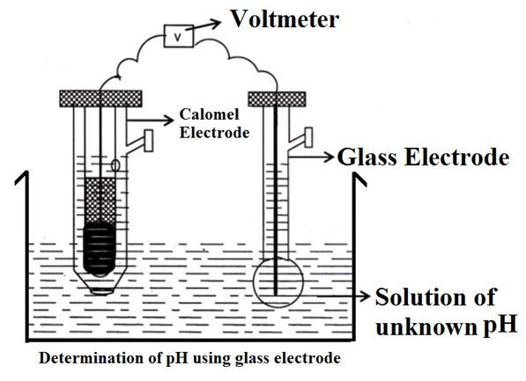
ENGINEERING CHEMISTRY
Module 4- Electrochemical equilibria
Determination of pH using glass electrode:
Glass electrode is combined with an external reference electrode
Hg/Hg₂Cl₂/Cl⁻//analyte solution/glass/0.1N HCl/AgCl/Ag
Source:https://utkarshiniedu.wordpress.com/2016/12/22/lecture-1-108-ion-selective-electrodes/

Slide 9
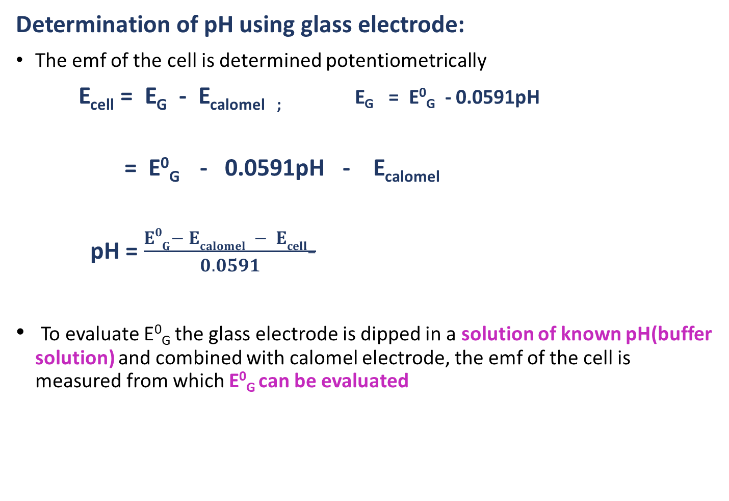
ENGINEERING CHEMISTRY
Module 4- Electrochemical equilibria
Determination of pH using glass electrode:
The emf of the cell is determined potentiometrically
E_{cell} = E_{G} - E_{calomel ;} E_{G} = E⁰_{G} - 0.0591pH
= E⁰_{G} - 0.0591pH - E_{calomel}
pH = $\frac{E0G− Ecalomel − Ecell−}{0.0591}$
To evaluate E⁰_{G} the glass electrode is dipped in a solution of known pH(buffer solution) and combined with calomel electrode, the emf of the cell is measured from which E⁰_{G} can be evaluated

Slide 10
ENGINEERING CHEMISTRY
Module 4- Electrochemical equilibria
Applications of glass electrode:
Used extensively in chemical, industrial, agricultural and biological labs
Advantages of glass electrode :
Can be used in oxidizing and reducing environments and metal ions
Does not get poisoned
Can be used for very small volumes
Accurate results can be obtained between pH 1 to 9 by ordinary electrodes. However by using special glass electrodes pH 1 to 14 can be measured with accuracy
Simple to operate and can be used with portable instruments

Slide 11
ENGINEERING CHEMISTRY
Module 4- Electrochemical equilibria
Disadvantages of glass electrode:
Because of high resistance of glass, a simple potentiometer cannot be used. It requires sensitive potentiometer for emf measurements
Glass membrane is very delicate, hence has to be handled carefully
At very high pH levels usually over a pH of 9 , Alkaline error is observed
H⁺ _{solution} + Na⁺Gl⁻ ⇌ Na⁺_{solution} + H⁺Gl⁻
When the Sodium ion level is relatively high, some of the H⁺ ions in the gel layer around the sensitive electrode membrane are replaced by Na⁺ ions
The electrode may eventually respond to Na⁺ instead of H⁺ ions, giving a false lower pH value than the actual value

Slide 12
THANK YOU
Lata Pasupulety
Department of Science and Humanities
latapasupulety@pes.edu
+91 80 6666 3333 Extn 759

